Slide 1
SPINAL CORD
Dr.Deepa.G.S
Associate Professor
Department of Physiology

Slide 2
Spinal cord
Situation:
Loosely in vertebral canal
Extends from foramen magnum where it is continuous with medulla oblongata above and up to lower border of first lumbar vertebra below

Slide 3
Spinal cord
Coverings of spinal cord- Meninges
Duramater
Piamater
Arachnoid mater
Protects and nourish the nervous tissue
Length
In males - 45cm
In females - 43 cm

Slide 4
Spinal cord
Conus medullaris
Below lumbar enlargements spinal cord narrows
to cone shaped termination
Filum Terminlae
Slender non-nervous filament extends from
conus medullaris downward to the fundus of
dural sac at the level of second sacral vertebra

Slide 5
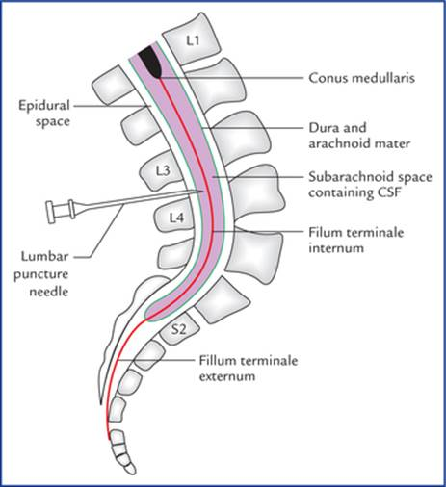
Spinal cord
https://doctorlib.info/anatomy/textbook-clinical-neuroanatomy/7.html

Slide 6
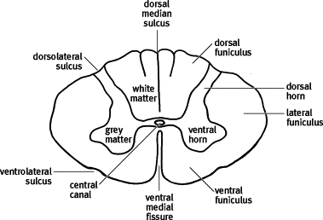
Fissure and sulci in spinal cord
https://www.sciencedirect.com/topics/veterinary-science-and-veterinary-medicine/arachnoid-mater

Slide 7
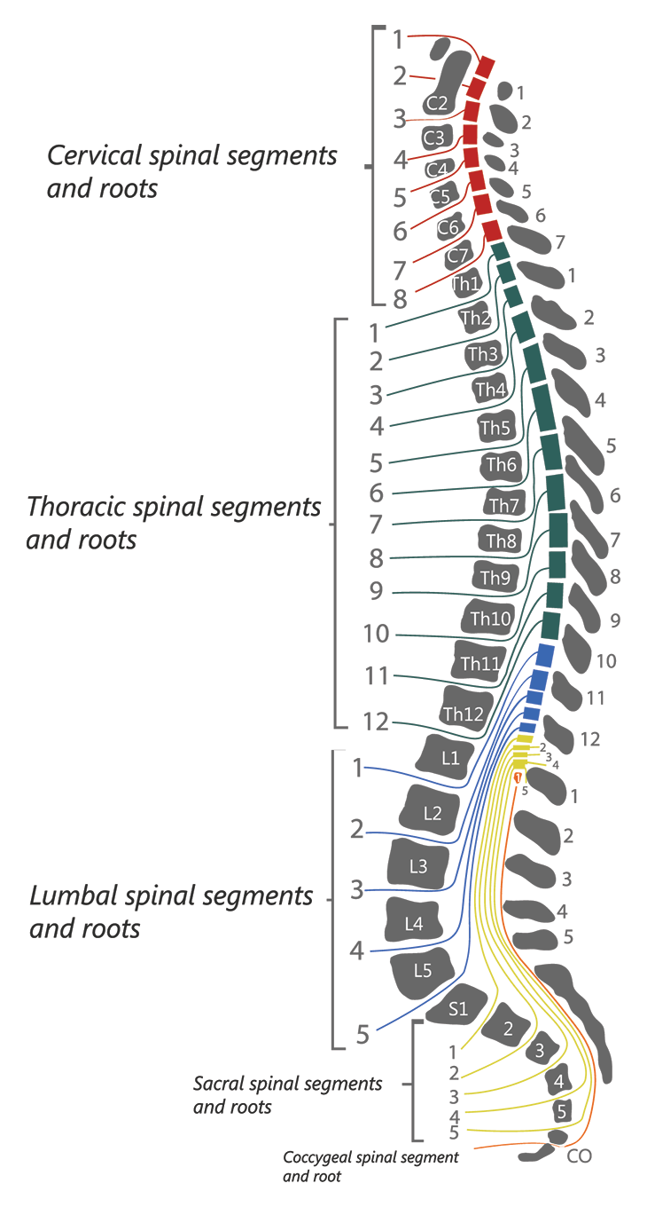
Segments of spinal cord
https://www.sci-info-pages.com/levels-and-classification/

Slide 8
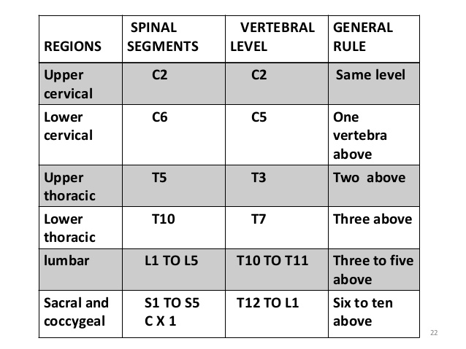
Spinal segments
https://www.slideshare.net/mgmcri1234/spinal-cord-2-58781472

Slide 9
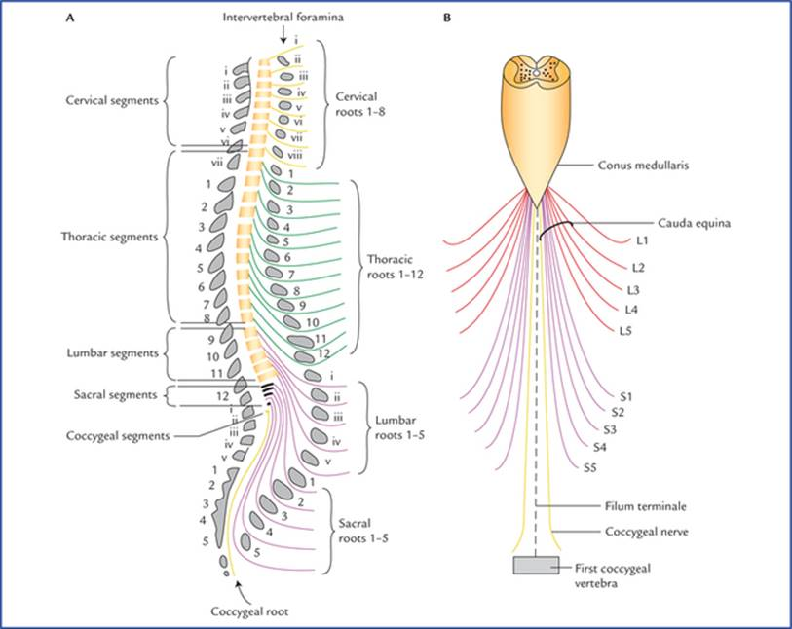
Spinal nerves
https://doctorlib.info/anatomy/textbook-clinical-neuroanatomy/7.html

Slide 10
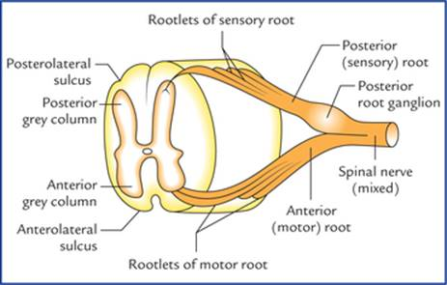
Spinal Nerve roots
https://doctorlib.info/anatomy/textbook-clinical-neuroanatomy/7.html

Slide 11
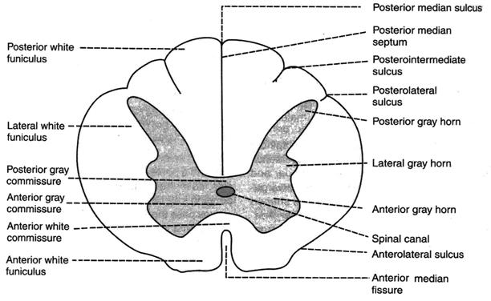
Section of spinal cord
https://studopedia.net/1_41602_Neurons-in-Anterior-Gray-Horn.html

Slide 12
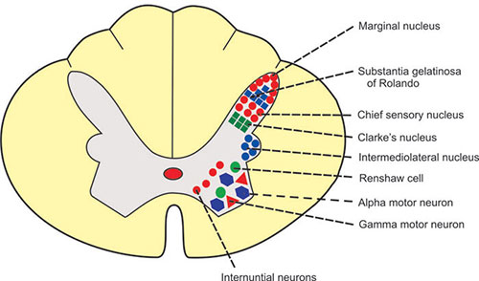
Nuclei of spinal cord
https://www.jaypeedigital.com/book/9789350250761/chapter/ch88

Slide 13
Tracts of spinal cord
Group of nerve fibers passing through spinalcord
Short tracts
Connects different parts of spinal cord itself
Association tracts: connects adjacent segments
Commissural tracts: Connects opposite halves of same segments of spinal cord
Long tracts
Connects spinal cord with other parts of central
nervous system

Slide 14
Spinal cord-Ascending Tracts
White column | Tract
Anterior White column | Anterior spinothalamic tract
Lateral white column | Lateral spinothalamic tract Ventral spinocerebellar Dorsal spinocerebellar Spinotectal tract Fasciculus dorsolateralis Spinoreticular tract Spino-olivary tract Spinovestibular tract
Posterior white column | Fasciculus gracilis Fasciciculus cuneatus Comma tract of schultze

Slide 15
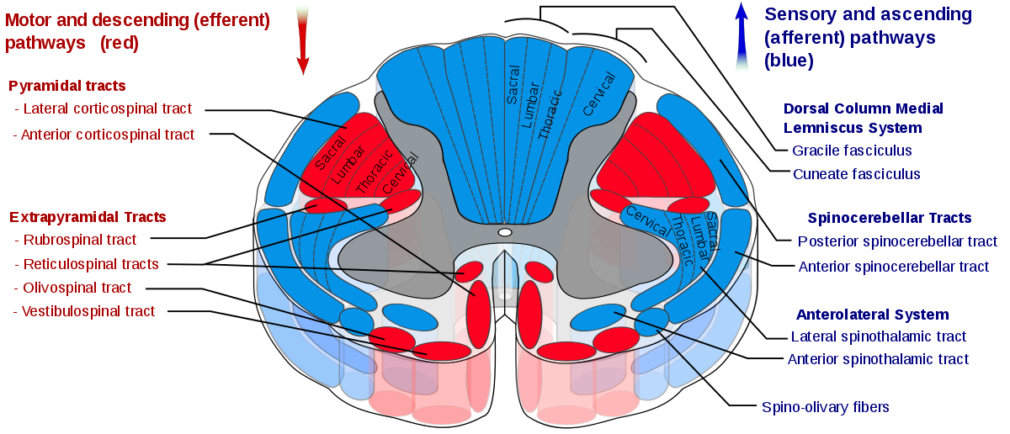
Tracts of spinal cord
https://en.wikipedia.org/wiki/Lateral_corticospinal_tract

Slide 16
Tracts of spinal cord
Every tract should be studied under the
following headings :
Origin
Course:
a. first order neuron
b. second order neuron
c. third order neuron
3. Termination
Function
Effect of lesion

Slide 17
Ascending Tracts of spinal cord
Ascending tracts carry impulses of various
sensations to the brain
Pathway of each sensation has 2or 3 groups of
neuron
First order neurons
Location: Cell body in post.nerve root ganglion
Peripheral process connects receptors
Central process enters spinal cord
Carry sensation from receptors to post.grey horn

Slide 18
Ascending Tracts of spinal cord
Second order neurons
Location: Post.grey horn
Forms the ascending tracts except post column
tracts
Carry sensation from spinal cord to subcortical
areas
Third order neurons
Location:Neurons in subcortical areas
Carry sensations from subcortical areas to
cerebral cortex

Slide 19
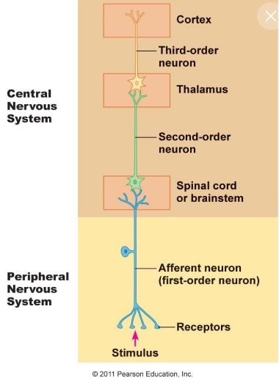
Ascending Tracts of spinal cord

Slide 20
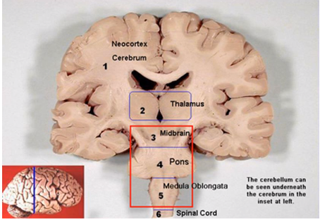
https://slideplayer.com/slide/4637418/

Slide 21
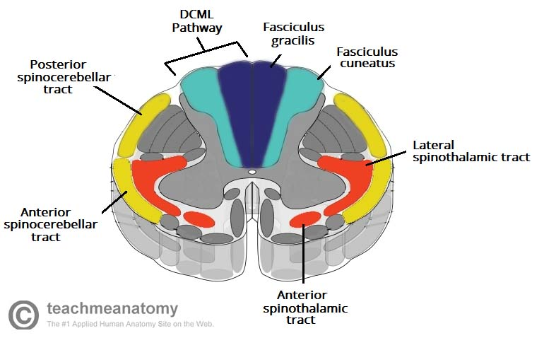
Ascending tracts of spinal cord

Slide 22
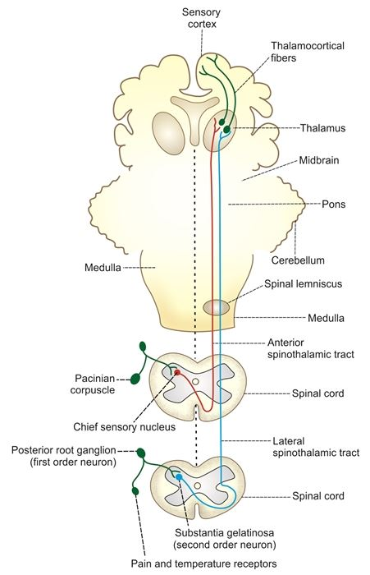
Anterior and Lateral Spinothalamic tract
https://www.jaypeedigital.com/book/9789385999468/chapter/ch94

Slide 23
Anterior spinothalamic tract(AST OR VST)
Carries sensation of crude touch
Origin: from axons of 1st order neurons in posterior root ganglia
Situation: in anterior white funiculus
Course:
First order neurons terminate in chief sensory nucleus of posterior gray horn cells
Second order neurons arise from here crosses to the opposite side in the anterior commissure, and ascend in the anterior white column of spinal cord

Slide 24
Anterior spinothalamic tract(AST OR VST)
On entering the medulla , it moves medially and along with lateral spinothalamic tract forms the spinal lemniscus and terminates in ventral postrolateral nucleus(VPN) of thalamus
Termination:
The 3rd order neurons arise from VPLN of thalamus ,forms thalamocortical projection, passes through posterior limb of internal capsule and corona radiata and terminates in the sensory area(somesthetic area I & II) of cerebral cortex
Function :
Carries impulses of crude touch(protopathic ) sensation

Slide 25
Anterior spinothalamic tract(AST OR VST)
Effect of lesion:
Unilateral-causes loss of crude touch sensation in the opposite side below the level of lesion
Bilateral-leads to loss of crude touch sensation on both sides below the level of lesion

Slide 26
Lateral spinothalamic tract
Carries sensation of pain and temperature sensation
Origin: from axons of 1st order neurons in posterior root ganglia
Situation: in lateral white funiculus
Course:
First order neurons terminate in marginal nuceus and substantia gelatinoss of Rolando of posterior gray horn cells
Second order neurons arise from here crosses to the opposite side in the anterior commissure, and ascend in the lateral white column of spinal cord

Slide 27
Lateral spinothalamic tract
On entering the medulla , it moves medially and along with anterior spinothalamic tract forms the spinal lemniscus and terminates in ventral postrolateral nucleus(VPN) of thalamus
Termination:
The 3rd order neurons arise from VPLN of thalamus ,forms thalamocortical projection, passes through posterior limb of internal capsule and corona radiata and terminates in the sensory area(somesthetic area I & II) of cerebral cortex
Function :
Carries impulses of pain and temperature sensation

Slide 28
Lateral spinothalamic tract
Effect of lesion:
unilateral-causes loss of pain and temperature sensation in the opposite side below the level of lesion
Bilateral-leads to loss of pain and temperature sensation on both sides below the level of lesion

Slide 29
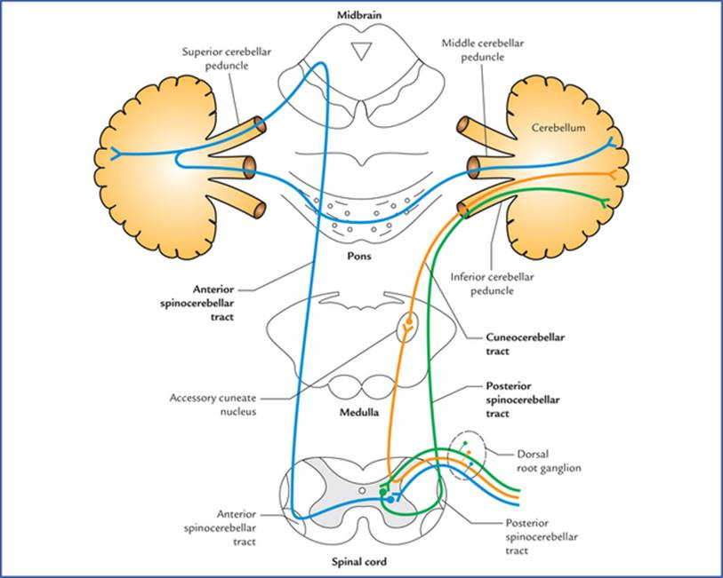
Spinocerebellar tracts-Gower’s and Flechsig tract
https://doctorlib.info/anatomy/textbook-clinical-neuroanatomy/17.html

Slide 30
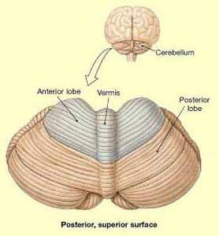
Cerebellum
https://www.medfriendly.com/cerebellar-vermis.html

Slide 31
Ventral spinocerebellar tract or Gower’s tract
Origin: from axons of 1st order neurons in posterior root ganglia
Situation: in lateral white funiculus
Course:
First order neurons terminate in marginal nucelus of posterior gray horn cells
Second order neurons arise from here (majority of fibers) cross opposite side and reach lateral column of opposite side and ascend through spinal segments,medulla ,pons and midbrain and reach cerebellum through superior cerebellar peduncle

Slide 32
Ventral spinocerebellar tract or Gower’s tract
Termination: Third order neuron from vermis
terminates in the anterior lobe of cerebellar
Corte along with dorsal spinocerebellar tract
Function: Carries the impulses of subconcious kinesthetic sensation
Effect of lesion:
causes loss of subconcious kinesthetic sensation in the oppsite side

Slide 33
Dorsal spinocerebellar tract or Flechsig tract
Origin: from axons of 1st order neurons in posterior root ganglia
Situation: in lateral white funiculus
Course:
First order neurons terminate in dorsal nucleus of Clarke of posterior gray horn cells
Second order neurons arise from here (majority of fibers) reach lateral column of same side and ascend through spinal segments and reach medulla. From there the fibers reach cerebellum through inferior cerebellar peduncle

Slide 34
Dorsal spinocerebellar tract or Flechsig tract
Termination: Third order neuron from vermis
terminates in the anterior and posterior lobes
of cerebellar cortex along with ventral
spinocerebellar tract
Function: Carries the impulses of subconcious kinesthetic sensation
Effect of lesion:
causes loss of subconcious kinesthetic sensation in the same side

Slide 35
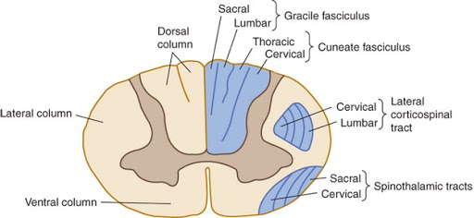
Ascending tracts-Post.column tracts
http://kypho.com/dorsal-column.html

Slide 36
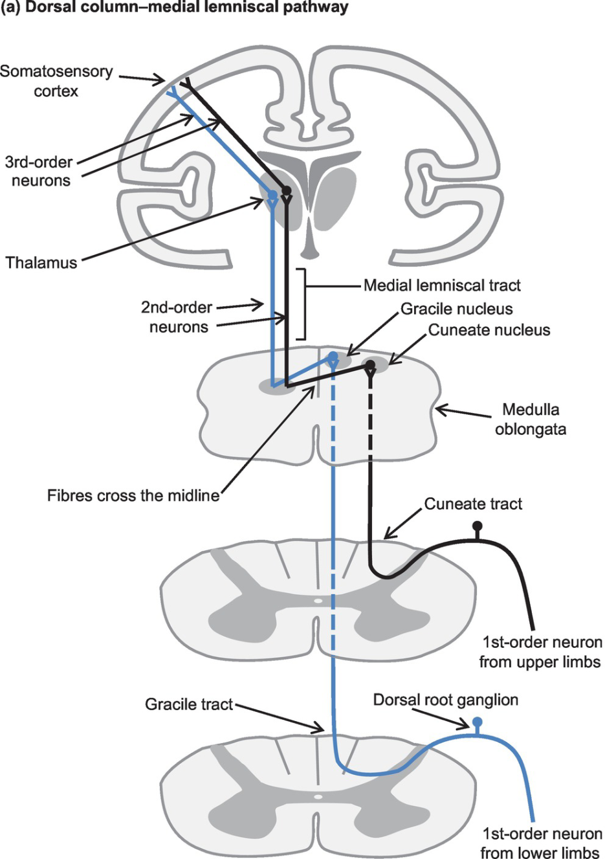
Posterior column tracts-Tract of Goll and Burdach
https://www.cambridge.org/core/books/basic-physiology-for-anaesthetists/spinal-cord/760FB3D659CF61DFC2A6A2B683E36A92

Slide 37
Posterior column tracts
Origin: from axons of 1st order neurons in posterior root ganglia
Situation: in post white funiculus
Course:
First order neurons ascend through post.white column without synapse. Some fibers descend and from comma tract of schultz
Fasciculus Gracilis contains fibers from lower parts of the body
Fasciculus Cuneatus contains fibers from upper parts of the body

Slide 38
Posterior column tracts
First order neurons terminate in medulla
Fibers of fasciculus gracilis –nucleus gracilis
Fibers of fasciculus cuneatus- nucleus cuneatus
Second order neurons
Neurons of medullary nuclei forms the second
order neuron
Axons of second order neurons forms the
internal arcuate fibers

Slide 39
Posterior column tracts
Internal arcuate fibers from both sides cross the midline forming sensory decussation and then ascend through pons and midbrain as medial lemniscus
Fibers of medial leminiscus terminate in VPLN of thalamus
Termination
From VPLN of thalamus fibers of of third order
neurons relay to sensory area of cerebral cortex

Slide 40
Posterior column tracts
Functions:
Fine tactile sensations
Tactile localization
Tactile discrimination two point discrimination
Sensation of vibration
Conscious kinesthetic sensation
Stereognosis

Slide 41
Posterior column tracts
Effect of lesion:
Loss of the above mentioned sensations on the same side below the lesion
Loss of proprioception, sensory ataxia

Slide 42
Tracts | Location | Origin | Course | Termination | Function
Anterior spinothalamic tract | Ant.White funiculus | Axon of first order neurons of PNG | Chief sensory nucleus Crossing in spinal cord, reach ant.white funiclus | VPLN of thalamus-Sensory cortex | Crude touch sensation
Lateral spinothalamic tract | Lat.White funiculus | Axon of first order neurons of PNG | Substantia gelatinosa of rolando,Marginal cells,Crossing in spinal cord reach lat.white funiclus | VPLN of thalamus-Sensory cortex | Pain and temperature
Ventral spinocerebellar | Lat.White funiculus | Axon of first order neurons of PNG | Clarke’s column of cells, Crossing in spinal cord reach lat.white funiclus | Red nucleus of midbrain-sup.cerebellar peduncle-cerebellum | Subconscious kinesthetic sensation
Dorsal spinocerebellar | Lat.White funiculus | Axon of first order neurons of PNG | Clarke’s column of cells,Uncrossed fibers reach lat.white funiclus | Medulla-inf.cerebellar peduncle-Cerebellum | Subconscious kinesthetic sensation
Fasciculs gracilis and cuneatus | Post.White funiculus | Axon of first order neurons of PNG | Uncrossed fibers of first order neurons- reach cuneatus and Gracilis nucleus in medulla-crossing in medulla | VPLN of thalamus-Sensory cortex | Fine touch Tactile localisation,Tactilediscrimnation, stereognosis, conscious kinesthetic sensation

Slide 43
Descending tracts of spinal cord
Formed by motor nerve fibers arising from brain and descend into the spinal cord
Carry motor impulses from brain to spinal cord
Descending tracts are of two types
Pyramidal Tracts
Extrapyramidal Tracts

Slide 44
Descending tracts of spinal cord
Type | Tracts
Pyramidal tracts | Extrapyramidal tracts
Corticospinal Tract | Medial longitudinal fasciculus
Anterior corticospinal tract | Ant.Vestibulospinal tract
Lateral corticospinal tract | lat.Vestibulospinal tract
Corticobulbar tract | Reticulospinal tract
 | Tectospinal tract
 | Rubrospinal tract
 | Olivospinal tract

Slide 45
Pyramidal tracts
First tract to be found in man
This is the longest tract starting from the motor cortex and reaching upto the last segment of the spinal cord.
These are otherwise known as corticospinal tracts-anterior and lateral corticospinal tract.
They give the appearance of a pyramid on the upper part of anterior surface of medulla.
Hence the name pyramidal tract.

Slide 46
Pyramidal tracts
Myelination of this fibers completes in 2years after birth
85%-90% of fibers in this system are of small diameter(less than 1µm)Hence Slow conducting pathway
There are about 1 million nerve fibers in each pyramidal tract
Fibers from the motor area to ventral horn cells and to all motor cranial nuclei except those supplying external eye muscles

Slide 47
Pyramidal tracts
Functionally, these tracts can be subdivided into
two:
Corticospinal tracts -Anterior and lateral
Supplies the musculature of the body.
Corticobulbar or cortico nuclear tracts
Supplies the musculature of the head and neck.

Slide 48
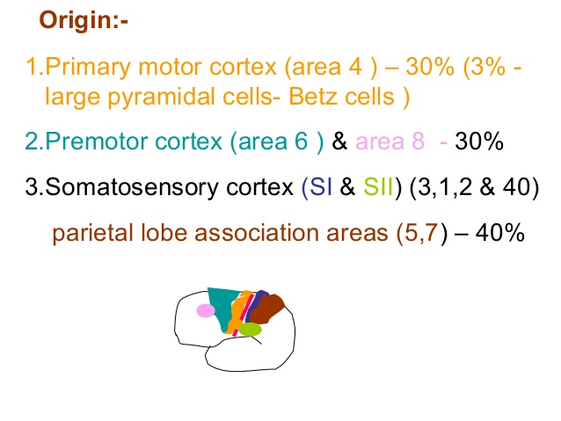
Pyramidal tracts
https://www.slideshare.net/PadmajaRDesai/pyramidal-tract-by-sunitamtiwaleprof-dept-of-physiologydypatil-medical-college-kolhapur

Slide 49
Pyramidal tracts
COURSE
CORONA RADIATA
After taking origin, the nerve fibers run downwards in a diffused manner through white matter of cerebral cortex. This fan-like structure is called corona radiata.
INTERNAL CAPSULE
While passing down towards the brainstem the corona radiata converges into the internal capsule. It is a mass of white fibers situated in between thalamus and caudate nucleus on the medial side and lenticular nucleus on the lateral side.
Fibers lie in the genu and ant.2/3rd of posterior limb

Slide 50
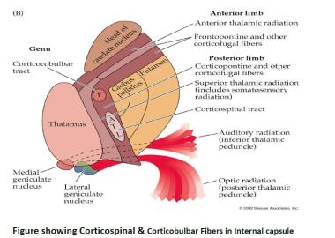
https://www.studyblue.com/notes/note/n/b3-has-internal-sc2/deck/2928968

Slide 51
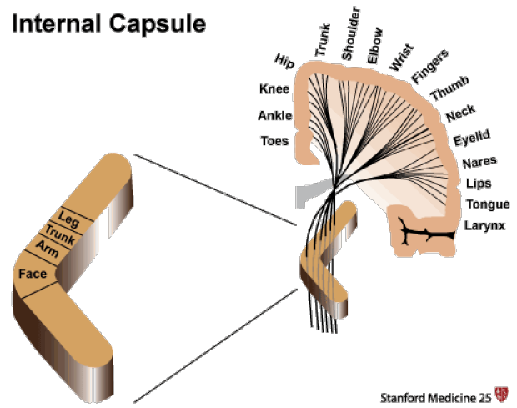

Slide 52
Pyramidal tracts
IN PONS
The fibers descend downwards through internal capsule, midbrain and pons. The fibers are divided into different bundles by the nuclei of pons.
At lower border of pons, the fibers are grouped once again into a compact bundle and then descend down into medulla oblongata.

Slide 53
Pyramidal tracts
IN MEDULLA
This compact bundle of corticospinal fibers gives the appearance of a pyramid in the upper part of medulla. So the corticospinal tracts are called pyramidal tract.
At the lower end of medulla, pyramidal tract on each side is divided into two bundles of unequal sizes.
About 80% of the fibres from each side cross the opposite side. While crossing the midline, the fibres of both sides form the pyramidal decussation

Slide 54
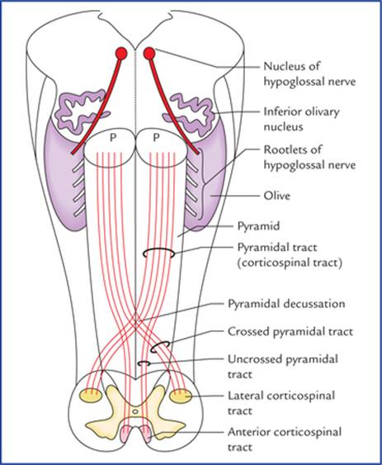
Pyramidal decussation
https://doctorlib.info/anatomy/textbook-clinical-neuroanatomy/8.html

Slide 55
Pyramidal tracts
IN SPINAL CORD
Fibres which cross the midline and form pyramidal decussation descend through posterior part of lateral white column of spinal cord.
This bundle of crossed fibers is called crossed pyramidal tract or lateral corticospinal tract.
Remaining 20%of fibers do not cross the opposite side but descend down through anterior white column of spinal cord. This is called uncrossed pyramidal tract or corticospinal tract.

Slide 56
Pyramidal tracts
Termination
•All fibers of pyramidal tract, both crossed and
uncrossed fibres terminate in the motor
neurons of anterior grey horn either directly or
via internuncial neurons.
•Pyramidal tract fibers terminate on both
α-motor neurons and γmotor neurons.

Slide 57
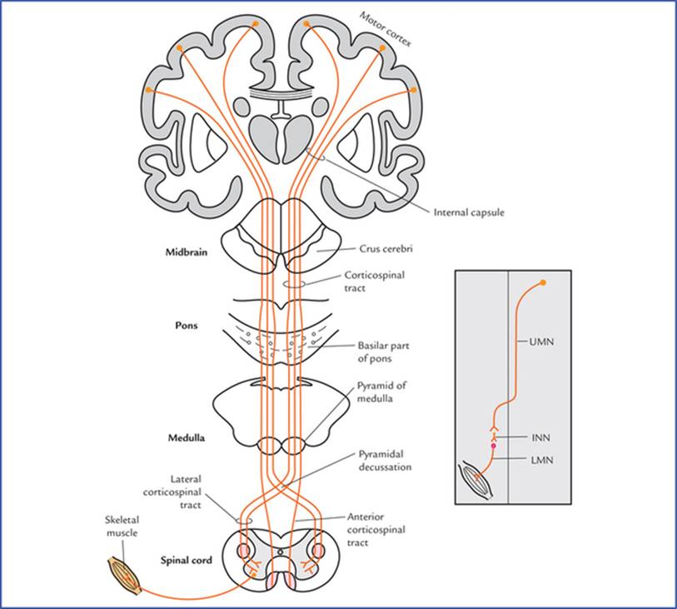
Pyramidal Tracts-Corticospinal
https://doctorlib.info/anatomy/textbook-clinical-neuroanatomy/17.html

Slide 58
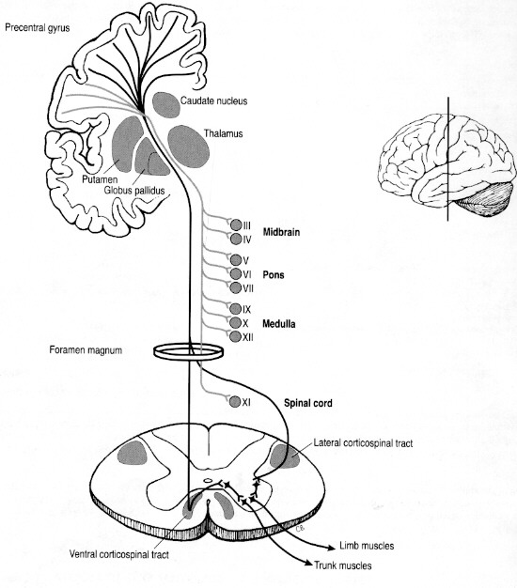
Corticobulbar tract
http://wiki.ahuman.org/index.php/MindTractsDT

Slide 59
Pyramidal tracts-Functions
• Convey motor impulses into the spinal cord for controlling the voluntary movements.
LCST: Voluntary movements of distal limb muscles and fine precise movements of fingers and hands to carry out skilled works
ACST:Control of muscles of trunk and proximal portions of limbs to carry out postural adjustments and gross movements

Slide 60
Pyramidal tracts-Functions
• Form a part of the pathways for superficial reflexes like cremasteric, abdominal and plantar reflexes.
Fibers from somatic sensory area I and II and parietal association area concerned with sensory –motor co-ordination.eg:Hand eye coordination
Corticobulbar tracts:
Voluntary control of muscles of larynx, pharynx, palate, upper and lower face ,jaw, eye etc
Lesion:pseudobulbarpalsy

Slide 61
Pyramidal tracts-Lesion
Effect of lesion
Loss of voluntary movements
Muscle tone increased-Spasticity
Spastic paralysis
Superficial reflexes lost
Deep reflexes exaggrated
Babinski’s sign positive

Slide 62
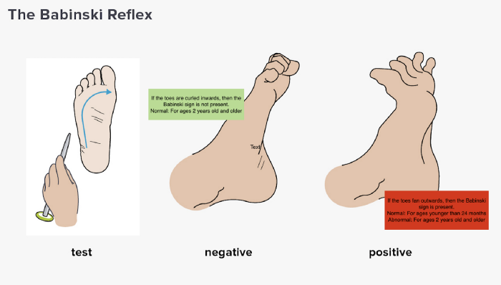
https://medium.com/@natasha.s.abraham/touch-your-babys-feet-it-could-be-a-sign-29fe4fe0d734

Slide 63
Pyramidal tracts-Lesion
Effect of lesion
At cerebral cortex
Causes hypertonia, spasticity and contralateral monoplegia or contralateral hemiplegia.
At internal capsule
Lesion of pyramidal tract fibers at posterior limb of internal capsule results in contralateral hemiplegia.

Slide 64
Pyramidal tracts-Lesion
Effect of lesion
Spinal cord
•Unilateral lesion of the lateral corticospinal fibers at upper cervical segment causes ipsilateral hemiplegia. Bilateral lesion causes-quadriplegia and paralysis of respiratory muscles
•Bilateral lesion of these fibers in thoracic and lumbar segments results in paraplegia without paralysis of respiratory muscles

Slide 65
Extrapyramidal tracts
Descending tracts of spinal cord other than pyramidal tract are called extrapyramidal tract. They are
Medial longitudinal fasciculus
Anterior vestibulospinal tract
Lateral vestibulospinal tract
Reticulospinal tract
Tectospinal tract
Rubrospinal tract
Olivospinal tract

Slide 66
Pyramidal tract vs Extrapyramidal tract
The pyramidal tracts may directly innervate motor neurons of the spinal cord or brainstem (anterior horn cells or certain cranial nerve nuclei)
The extrapyramidal system centers on the modulation and regulation (indirect control) of anterior horn cells.

Slide 67
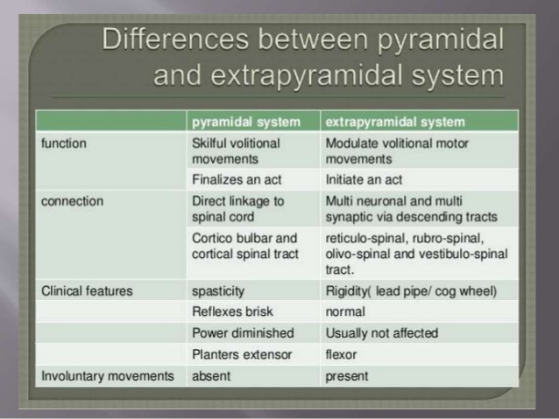
https://www.slideshare.net/sarvanshikhalora/pyramidal-and-extrapyramidal-tracts-of-spinal-cord-by-sk

Slide 68
Tracts | Location | Origin | Function
Medial longitudinal fasciculus | Ant white column | Medial vestibular nuclei, Reticular formation, Superior colliculus, Interstitial nucleus of cajal (brainstem) | Coordination of refelex ocular movements. Integration of movements of eyes and neck
Ant.vestibulospinal tract | Ant white column | Medial vestibular nucleus (Pons and medulla) | Maintainence of muscle tone and posture Maintenance of position of head and body during acceleration
Lat.vestibulospinal tract | Lat white column | Lateral vestibular nucleus (Pons and medulla)
Reticulospinal tract | Lat white column | Reticular formation of pons and medulla | Co-ordination of voluntary and reflex movements Control of muscle tone Control of respiration Control of diameter of blood vessels

Slide 69
Descending Tracts
Tracts | Location | Origin | Function
Tectospinal tract | Ant. white cloumn | Sup.colliculus (Midbrain) | Control of movements head in response to visual and auditory stimuli
Rubrospinal tract | Lat. white cloumn | Nucleus magnocellularis of Red nucleus (Midbrain) | Facilitatrory influence on flexor muscle tone
Olivoospinal tract | Lat. white cloumn | Inf.Olivary nucleus (Medulla) | Control of movements due to proprioception

Slide 70
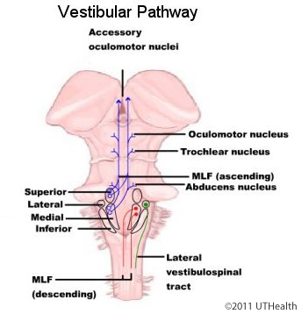
https://nba.uth.tmc.edu/neuroanatomy/L6/Lab06p18_index.html

Slide 71
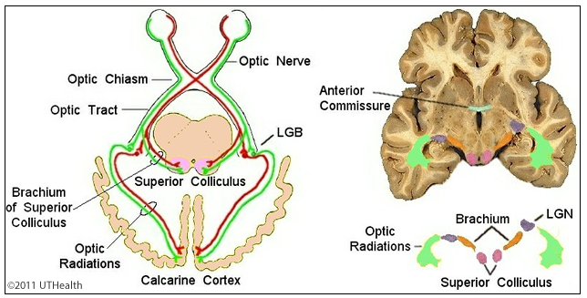
https://nba.uth.tmc.edu/neuroanatomy/L7/Lab07p07_index.html

Slide 72
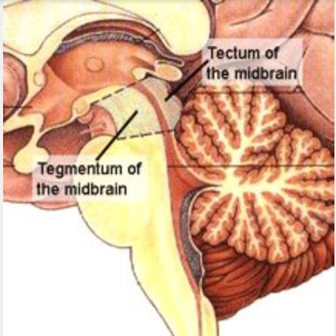
Tectum of midbrain
https://operativeneurosurgery.com/doku.php?id=tectum

Slide 73
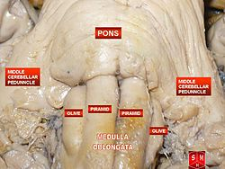
Olivary nucleus

Slide 74
UMN VS LMN lesion
Lower motor Neuron | Upper motor neuron
Single or individual muscle affected | Involves group of muscles
Loss of muscle tone-Flaccid paralysis | Hypertonic-spastic paralysis Cause: Loss of higher inhibitory control Denervation hypersensitivity of centers below the lesion
Disuse atrophy of muscle-shrinkage of muscle and replaced by fibrous tissue | Muscle atrophy is not severe
Superficial reflexes-absent Deep reflexes-absent | Superficial reflexes-abdominal,cremastric and anal reflexes lost Deep reflexes-Hyperactive due to increased gamma motor discharge
Babinski’s sign-not elicited | Babinski’s sign-elicited

Slide 75
Babinski’s sign
Procedure
Stroke the outer edge of the sole of foot with
firm tactile stimulus from heel towards little toe
and then medially across the metatarsals
Babinski’s positive sign
Dorsiflexion of great toe and fanning out of
other toes
Normal plantar reflex: Plantar flexion of great
toe and small toes with adduction

Slide 76
Babinski’s sign
Causes:
Infants below one year of age as pyramidal tracts are not developed
During deep sleep
Inhibition of pyramidal tracts
Cheyne stokes respiration due to hypoxia

Slide 77
https://medium.com/@natasha.s.abraham/touch-your-babys-feet-it-could-be-a-sign-29fe4fe0d734

Slide 78
Hemisection of spinal cord-Brown sequard syndrome
Hemisection-lesion involving lateral half of
spinal cord
Functional changes can be divided into three
categories
Below the level of lesion
At the level of lesion
Above the level of lesion

Slide 79
Brown sequard syndrome
Changes below the level of hemisection
On same side
Sensory changes
Sensations carried by uncrossed tracts lost
loss of fine touch , tactile localization and tactile
discrimniation , vibration sense due to damage of
dorsal column tracts
Sensations carried by crossed tracts retained
Pain, temperature and crude touch sensation
unaffected-Spinothalmic tracts carrying this sensation cross to opposite side

Slide 80
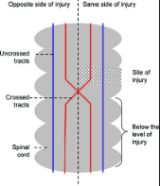
Hemi section of spinal cord- Brown sequard syndrome
https://www.jaypeedigital.com/book/9788180618260/chapter/ch143

Slide 81
Brown sequard syndrome
Motor changes
Extensive uppermotor neuron type paralysis
due to damage of crossed pyramidal tracts
Temporary loss of vasomotor tone due to
damage to descending fibers of VMC in
medulla-Dilatation of blood vessels and fall of BP

Slide 82
Brown sequard syndrome
On the opposite side
Sensory changes
Sensations carried by crossed tracts lost
Damage of spinothalamic tract-Complete loss of pain , temperature and crude touch
Sensations carried by crossed tracts lost
Fine touch, tactile localization and tactile discrimination, vibration sense retained-Intact dorsal column tract

Slide 83
Brown sequard syndrome
Motor changes
Either no paralysis or paralysis of few muscles occurs.
This is due to possible involvement of some fibers of direct pyramidal tract of the same side when these fibers cross

Slide 84
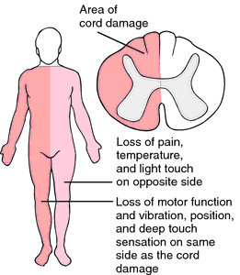
Brown sequard syndrome
https://loonylabs.org/2020/02/12/day177-365doa

Slide 85
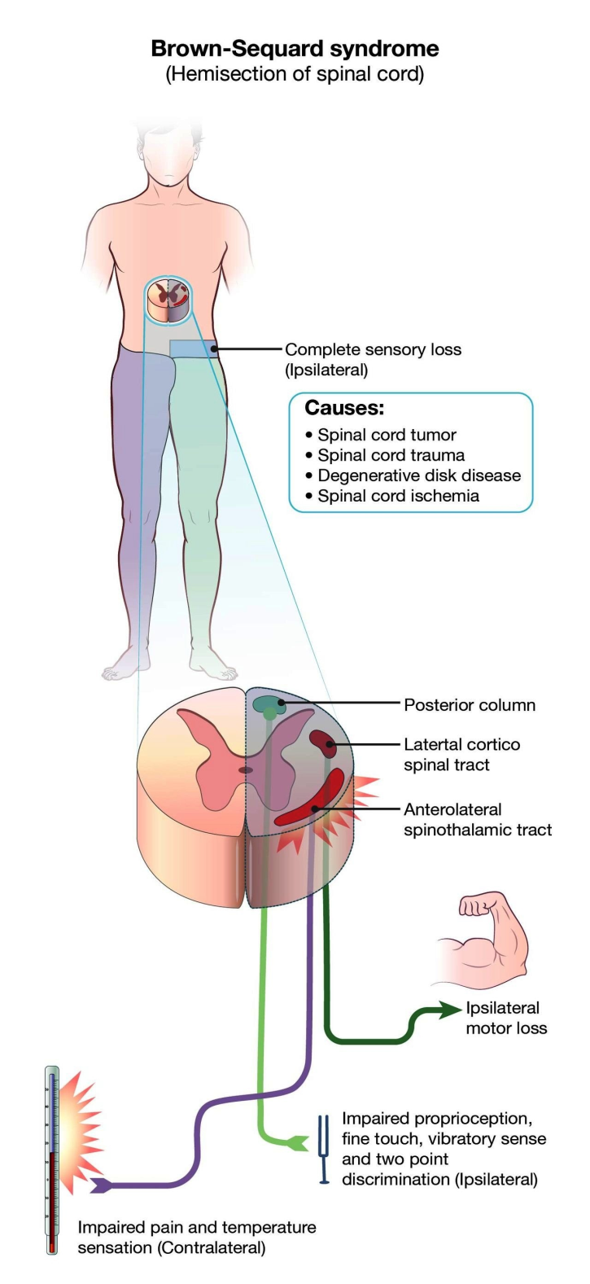

Slide 86
Changes at the level of hemisection
On the same side
Sensory changes
Complete anesthesia occurs due to damage to post nerve root, post horn cells and spinothalamic fibers
Motor changes
Complete LMN type paralysis due to damage to anterior horn cells
Complete and permanent vasomotor paralysis due to damage of lateral horn cells

Slide 87
Changes at the level of hemisection
On the opposite side
Sensory changes
Sensation carried by crossed tracts lost
Sensation by uncrossed tracts retained
Motor changes
Nil or very slight

Slide 88
Changes above the level of hemisection
On same side
A band of hyperaesthesia
On opposite side
hyperaesthesia

Slide 89
Syringomyelia
Syrinx-cyst or cavity
Myelia-spinal cord
Cystic enlargement of spinal cord

Slide 90
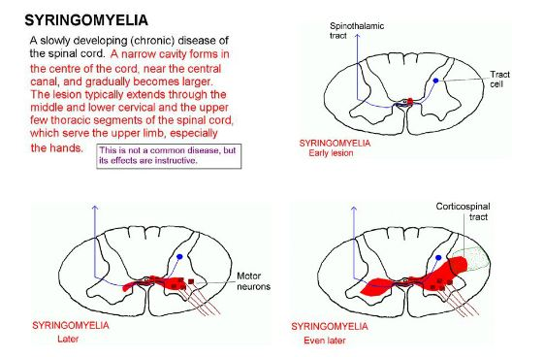
http://humanphysiology.academy/Neurosciences%202015/Chapter%202/CL.2%20Syringomyelia.html

Slide 91
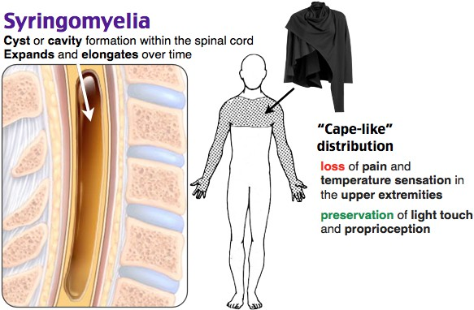
Syringomyelia
https://www.grepmed.com/images/5080/syringomyelia-neurology-diagnosis

Slide 92
Syringomyelia
Syringomyelia is spinal cord disorder characterized by the presence of
fluid-filed cavities in the spinalcord.
Gray matter around the central canal is the most affected part.
So the sensory disturbances are more pronounced than the motor disturbances.
CAUSE
Over growth of neuroglial cells in spinal cord accompanied by cavity formation and accumulation of fluid.
Initially, a cavity appears in gray matter near the central canal of spinal cord.
In later stages, the cavity extends and involves the surrounding white matter to a variable degree.
The disease usually starts in one or two segments.
Then, it extends up and down for considerable distances.
Lower cervical and upper thoracic regions are affected the most.

Slide 93
Syringomyelia
SYMPTOMS
If disease is only around central canal, there is
loss of temperature, pain and crude touch sensations only.
It is due to lesion of the fibres crossing through the anterior gray commissure.
Fine touch sensation is not affected
If lesion is unilateral, effect occurs only on the same side.

Slide 94
Syringomyelia
If disease extends to posterior gray horn, all the sensations are lost
The affected persons become prone for injuries. Since, the injury is not perceived it leads to severe damage to the tissues.
If anterior gray horn is affected, there is flaccid paralysis of muscles.

Slide 95
Syringomyelia
In later stages, both pyramidal and extrapyramidal tracts are also involved, if the disease spreads to white matter.
It causes spastic paralysis of limbs, especially in lower limbs, resulting in spastic paraplegia.
Weakness and wasting of small muscle of limbs occur.
Winging of scapula and scoliosis (lateral curvature of spine) develops.

Slide 96
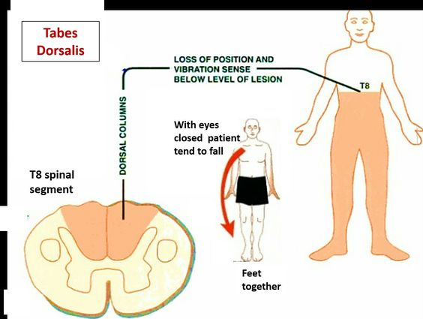
Tabes Dorsalis
https://ro.pinterest.com/pin/292734044529247529/

Slide 97
Tabes dorsalis
Tabes dorsalis is another disease of the spinal cord.It is a slowly progressive nervous disorder affecting both the motor and sensory functions of spinal cord.
CAUSES
It occurs due to the degeneration of posterior (sensory) nerve roots.
It usually occurs in syphilis.
Posterior nerve roots are affected proximal to the posterior root ganglia.
Ganglia are not affected.
Among the fibers of posterior root, the fibers of lateral division are affected much.
Reason for this type of selective degeneration is not known.

Slide 98
Tabes dorsalis
FEATURES
Symptoms may not appear for some decades after the initial infection
Weakness, diminished reflexes, unsteady gait, progressive degeneration of the joints, loss of coordination, episodes of intense pain and disturbed sensation, personality changes, dementia, deafness, visual impairment, and impaired response to light.

Slide 99
Reference:
Text book of Medical Physiology:Geetha N 2nd edition
Essentials of medical Physilology:K.sembulinhgam Prema sembulingam,Eigth edition
Text book of Physiology:Prof.A.K.Jain,Fourth edition

Slide 100
Thank You

